Slide 1
Deep learning-based NLP data pipeline for
EHR-scanned
document information extraction
DSCI560
Instructor：Young Cho, Ph.D.
Yifan Yang
8386626867

Slide 2
INTRODUCTION and RELATED WORK
Highlights from what I read：
1. Common methods for processing scanned documents include image preprocessing, optical processing character recognition (OCR) and text mining, but have limitations and these methods have an impact on each other.
2. The first data pipeline using Transformer-based NLP model for information extraction from scanned document information is proposed and other machine learning and deep learning methods are summarized and evaluated.
3. Documentation typically involves two sequential steps: OCR and text mining.
The research develops a processing pipeline that leverages deep learning: a connectionist text proposal network (CTPN) for text detection and an attention-based encoder-decoder (AED) for text recognition. However, there are still problems. The main problem is that what is missing is an understanding of the interaction of how to extract this information, especially using modern machines. This paper hopes to bridge this gap as much as possible.
SECTION TITLE | 2
SECTION TITLE | 2

Slide 3
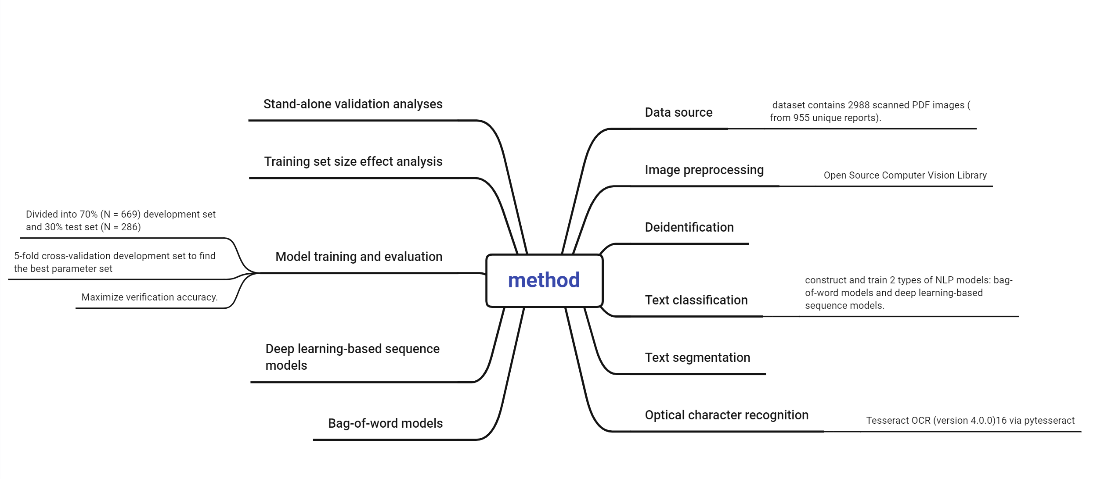
METHODS

Slide 4
RESULTS
Highlights from what I read：
1. Note that in some reports, part of the image is treated as text. Notice that there are some misspelled words in the output.
2. In the first experiment, deep learning-based sequence models generally performed better than bag-of-words models. Most bag-of-words models have high segmentation accuracy. But the recall rate of sequence model is much higher. BERT and ClinicalBERT show the highest F1 scores. At the document level, sequence models have higher accuracy.
3. In the second experiment, the impact of different training set sizes was examined to reflect real-world conditions where large amounts of training data are often unavailable. To summarize the second experiment, ClinicalBERT performs
The less training data the better. Different image preprocessing methods were evaluated before using ClinicalBERT. Different sequence model architectures were also evaluated.

Slide 5
DISCUSSION
The study design minimized the need for manual annotation.
Sample size experiments show that the BERT-based sequence model can achieve 90% accuracy with a small amount of training, indicating that the flexibility of transaction small-scale performance significantly reduces annotation costs.
Our evaluation shows that ClinicalBERT achieves the best results for AUROC and documentation accuracy.
To the best of our knowledge, the use of word position and layout in NLP models has not been reported yet. We believe this is a new direction for optimizing NLP model performance.
It's important to note that the study does have some limitations.

Slide 6
CONCLUSION
The results fill a gap in the field by providing comprehensive documentation of EHR scans that address the assessment of every moving part.
Q1: When using BERT-based sequence models for text classification tasks, why are both pre-training and fine-tuning stages necessary and does a small amount of training make sense?
A1:
BERT is a deep learning model based on Transformer. In the pre-training stage, the BERT model captures the deep features of language, such as the relationship between words, sentence structure and contextual meaning, by understanding a large amount of unlabeled text (such as case content). According to the paper, the BERT-based sequence model can achieve 90% accuracy with a small amount of training, indicating that the flexibility of small-scale transaction performance significantly reduces the labeling cost and is therefore meaningful.

